Slide 1
The Authority Control Task List Examples
Yoel Kortick – Senior Librarian

Slide 2
  Introduction
  Preferred Term Correction - BIB heading found no authorized term
  Linking - BIB heading found no matching AUT headings
  Linking – BIB heading found multiple matching AUT headings (ambiguous)
  AUT record deleted - Unlinked BIB heading
  Preferred Term Correction - BIB heading updated

Slide 3


Introduction

Slide 4
Introduction
This presentation will show examples of what is retrieved via the authority control task list.
For a full feature presentation of the authority control task list see The Authority Control Task List.pptx

Slide 5

Preferred Term Correction - BIB heading found no authorized term

Slide 6
Preferred Term Correction - BIB heading found no authorized term
Preferred Term Correction – BIB heading found no authorized term | This option references updates to the bibliographic record with the value of the preferred term of the linked authority record. When the linked authority record does not have a preferred term matching the nonpreferred term (such as when the nonpreferred term is registered in the 410 field and the preferred term is in the 100 field), the bibliographic record is not updated.

Slide 7
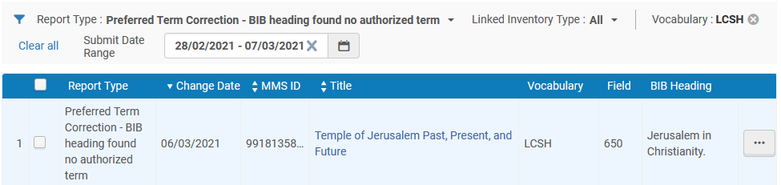
Preferred Term Correction - BIB heading found no authorized term

Slide 8
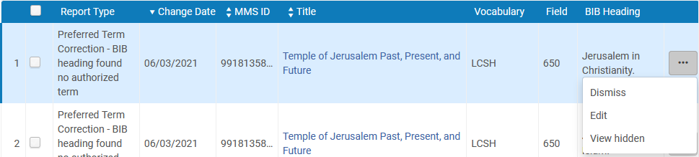
Preferred Term Correction - BIB heading found no authorized term
We will edit the entry

Slide 9
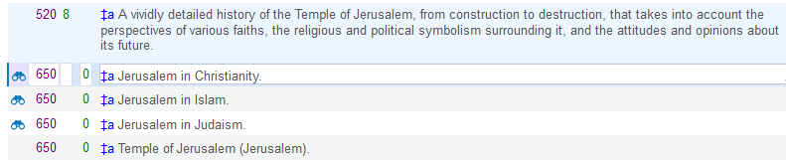
Preferred Term Correction - BIB heading found no authorized term
Heading “Jerusalem in Christianity” is catalogued as a Subject Added Entry-Topical Term (650) heading of type vocabulary “LCSH”

Slide 10
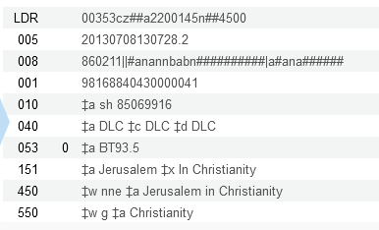
Preferred Term Correction - BIB heading found no authorized term
The linked authority record has different 3rd digits for the preferred term and non preferred term. Instead of a 150 and 450 there is a 151 and a 450. The 650 of the bibliographic record is thus linked to a 151 of an authority record.

Slide 11

Linking - BIB heading found no matching AUT headings

Slide 12
Linking - BIB heading found no matching AUT headings
Linking – BIB heading found no matching AUT headings | This option references attempts to find a link between a heading in the bibliographic record and an authority headings record. When no matching authority headings record is found, you may want to review the information in the bibliographic record.

Slide 13
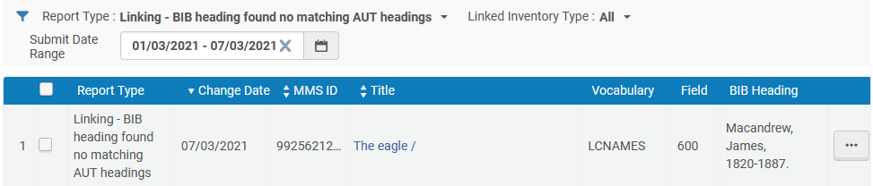
Linking - BIB heading found no matching AUT headings
Example 1 of 2

Slide 14
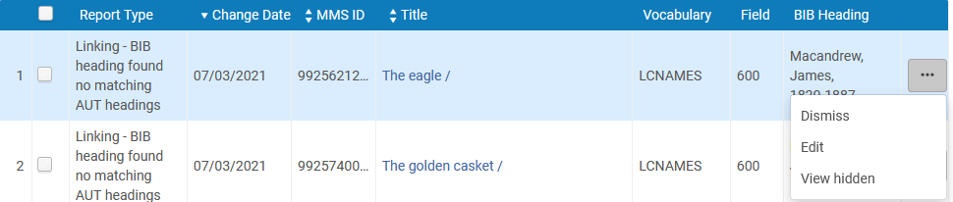
Linking - BIB heading found no matching AUT headings
Example 1 of 2
We will edit the entry

Slide 15
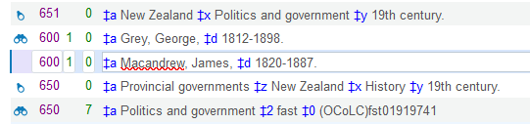
Linking - BIB heading found no matching AUT headings
Example 1 of 2
Heading “Macandrew, James, 1820-1887.” is catalogued as an Subject Added Entry-Personal Name (600) of type LCNAME

Slide 16
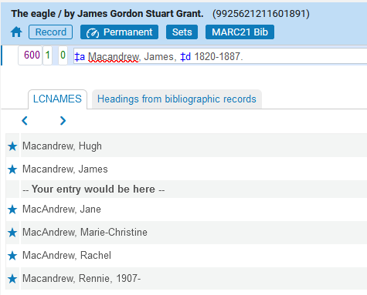
Linking - BIB heading found no matching AUT headings
Example 1 of 2
However, there is no heading “Macandrew, James, 1820-1887.” which is a Subject Added Entry-Personal Name of type LCNAME

Slide 17
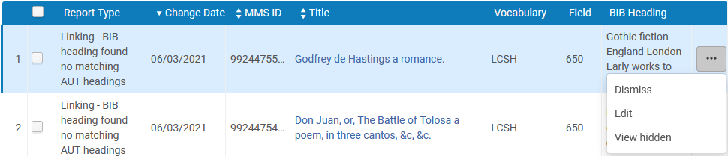
Linking - BIB heading found no matching AUT headings
Example 2 of 2
We will edit the entry

Slide 18
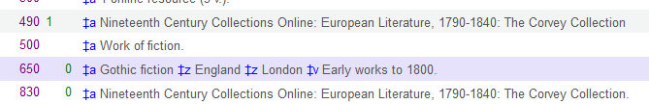
Linking - BIB heading found no matching AUT headings
Example 2 of 2
Heading “Gothic fiction England London Early works to 1800” is catalogued as a Library of Congress Subject Heading (LCSH).
Subfield a is “Gothic Fiction”

Slide 19
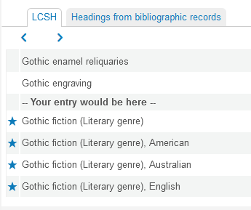
Linking - BIB heading found no matching AUT headings
Example 2 of 2
However, there is no heading “Gothic fiction” which is a LCSH

Slide 20

Linking – BIB heading found multiple matching AUT headings (ambiguous)

Slide 21
Linking – BIB heading found multiple matching AUT headings (ambiguous)
Linking – BIB heading found multiple matching AUT headings (ambiguous) | This option references attempts to find a link between a heading in the bibliographic record and an authority headings record. In some cases, multiple matches are found. You need to review the possible matches to decide which is the correct one.

Slide 22
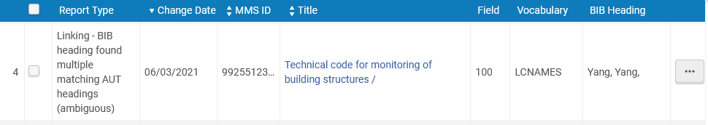
Linking – BIB heading found multiple matching AUT headings (ambiguous)

Slide 23
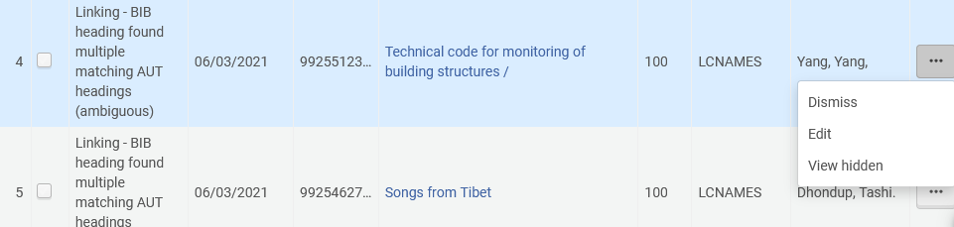
Linking – BIB heading found multiple matching AUT headings (ambiguous)
We will edit the entry

Slide 24
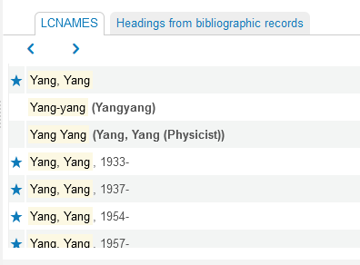
Linking – BIB heading found multiple matching AUT headings (ambiguous)
Heading “Yang, Yang, ” is catalogued as a “LCNAME”, but there are several with different dates.

Slide 25

AUT record deleted - Unlinked BIB heading

Slide 26
AUT record deleted - Unlinked BIB heading
AUT record deleted - Unlinked BIB heading | This option references authority records that have been deleted and manual handling may be needed.

Slide 27
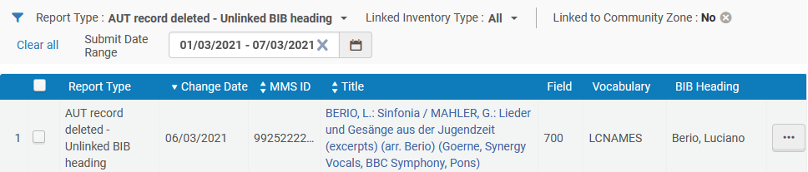
AUT record deleted - Unlinked BIB heading
Example 1 of 2

Slide 28
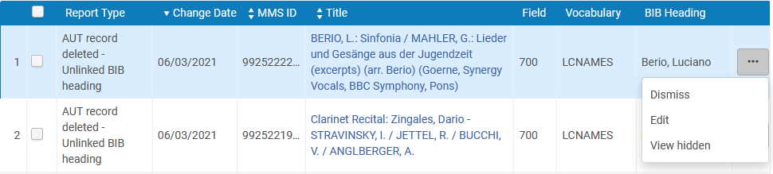
AUT record deleted - Unlinked BIB heading
Example 1 of 2
We will edit the entry

Slide 29
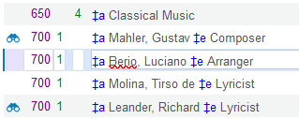
AUT record deleted - Unlinked BIB heading
Example 1 of 2
Heading “Berio, Luciano” is catalogued as a “LCNAME”, but is not linked to an authority record because the authority record was deleted.

Slide 30
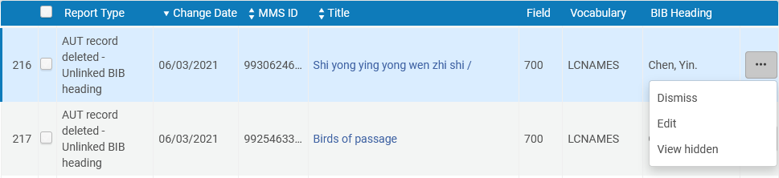
AUT record deleted - Unlinked BIB heading
Example 2 of 2
We will edit the entry

Slide 31
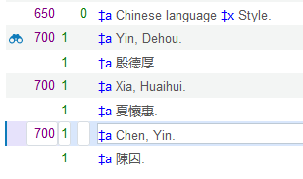
AUT record deleted - Unlinked BIB heading
Example 2 of 2
Heading “Chen, Yin” is catalogued as a “LCNAME”, but is not linked to an authority record because the authority record was deleted.

Slide 32

Preferred Term Correction - BIB heading updated

Slide 33
Preferred Term Correction - BIB heading updated
Preferred Term Correction – BIB heading updated | This option references updates to the bibliographic record with the value of the preferred term of the linked authority record. When this update is successful, the entry shows the value of the bibliographic record before and after the change.

Slide 34
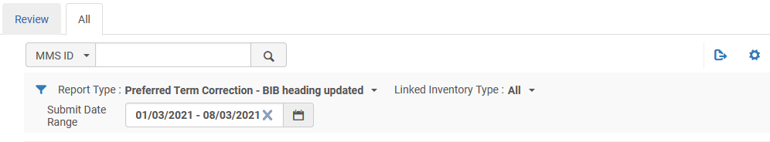
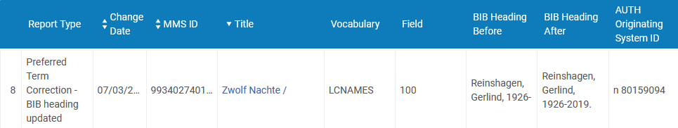
Preferred Term Correction - BIB heading updated
Here we use the “All” tab. Previous examples used the “Review” tab.

Slide 35
Preferred Term Correction - BIB heading updated
Here is the bibliographic heading before and after the change
We will click the title to go to the record

Slide 36
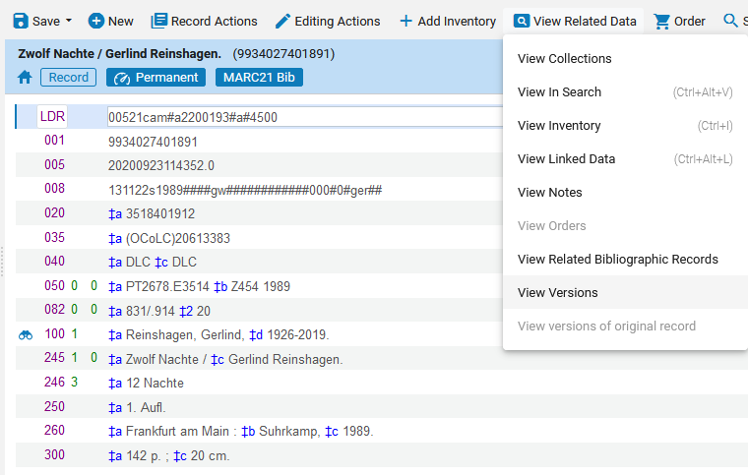
Preferred Term Correction - BIB heading updated
Here is the heading. Let’s “View Versions”

Slide 37
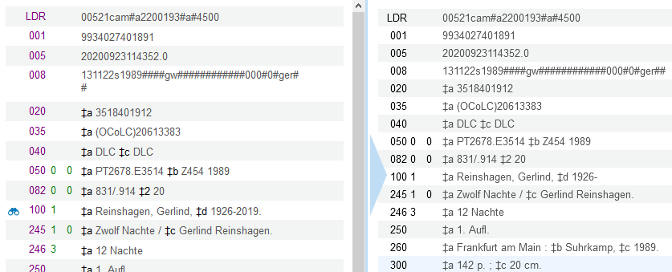
Preferred Term Correction - BIB heading updated
We can see that the heading was changed

Slide 38
xxx@exlibrisgroup.com

